Slide 1

IOT ENABLED SMART COVID PREVENTION DOOR
In Guidance of
Professor: Dr Priyanka Bagade
TA: Aman Singh
By Group no. 6
Ankit Raja
Anuj Shrivastava
Himanshu Lal
Manish

Slide 2
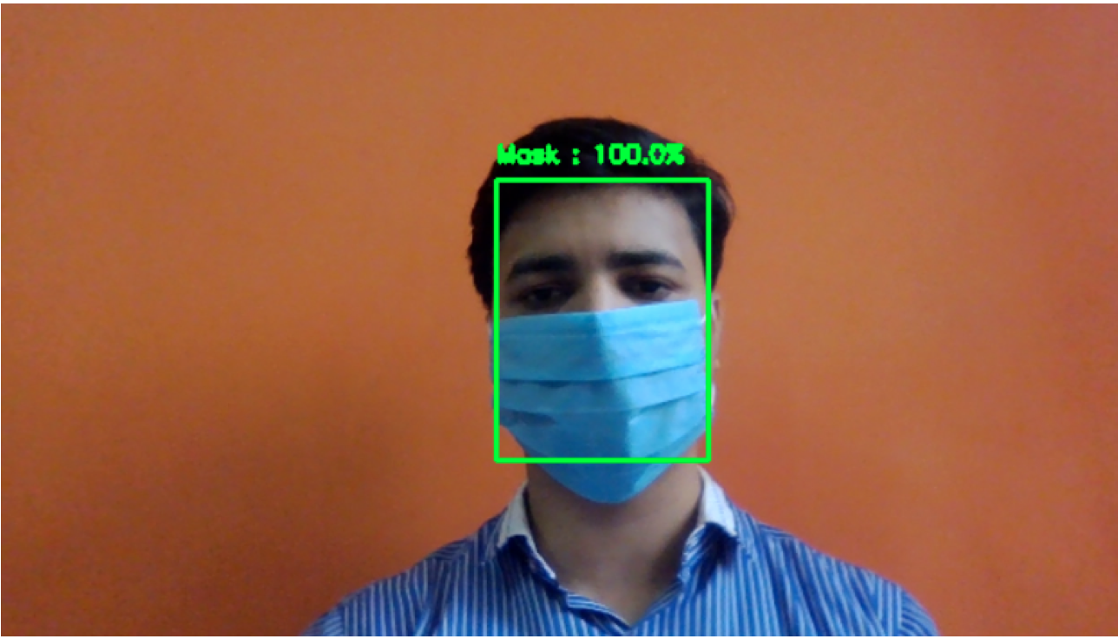
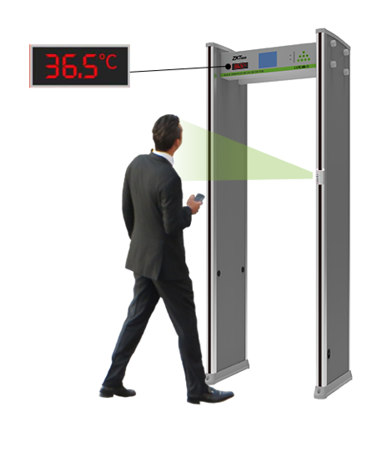
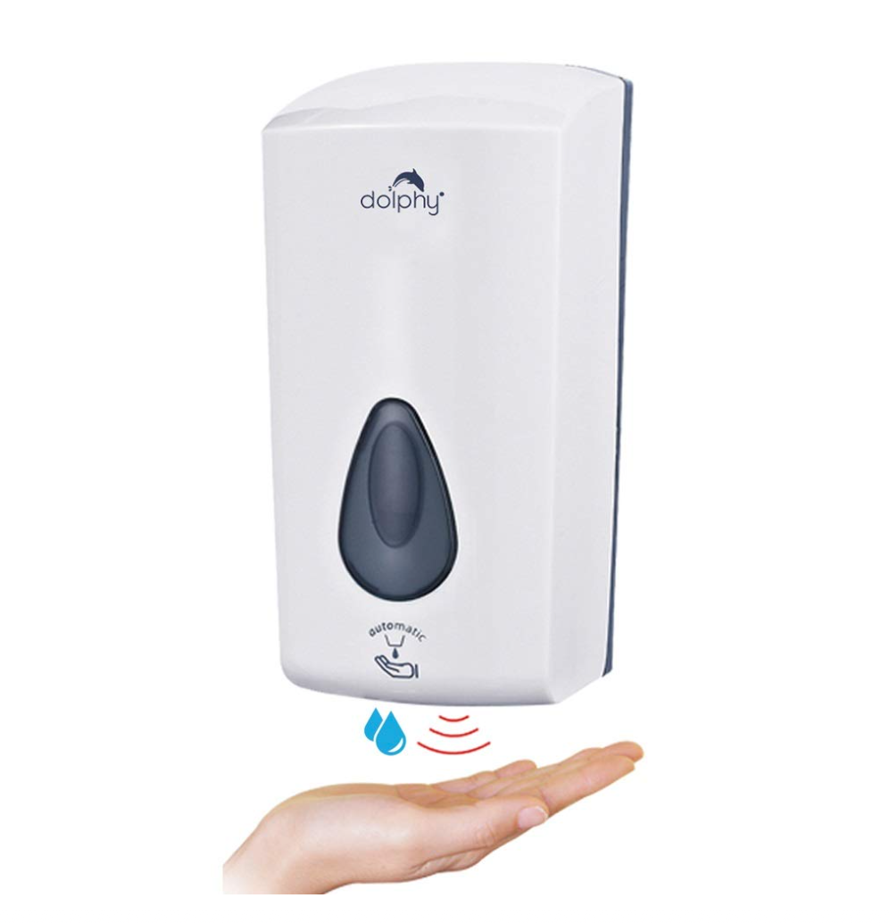
INTRODUCTION:
Detecting the Face Mask
Detecting the temperature of human body
Automatic hand sanitizer
Allowing only up to a certain number of people inside room/office

Slide 3
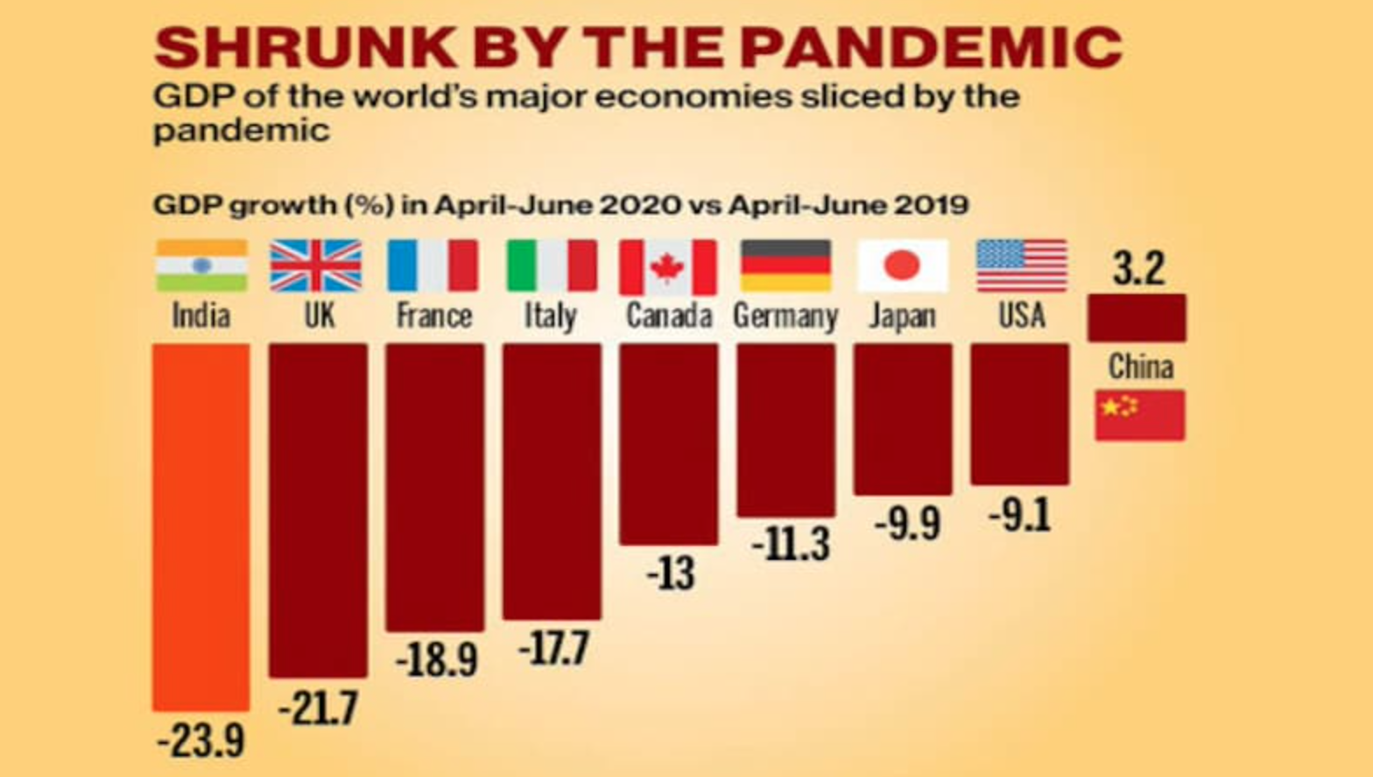
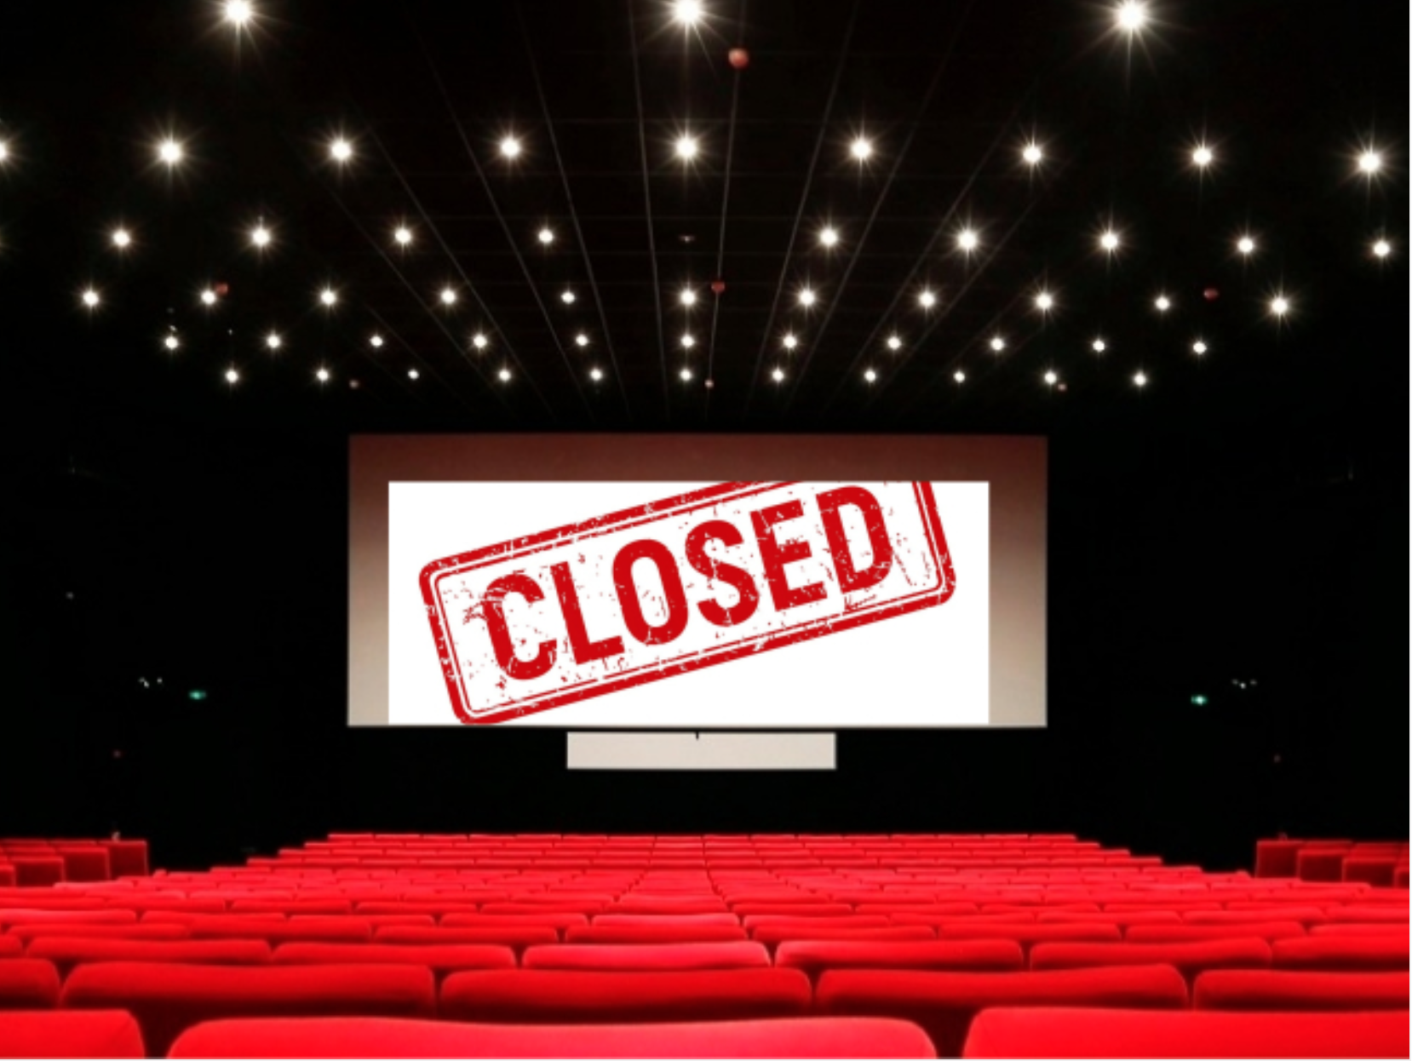
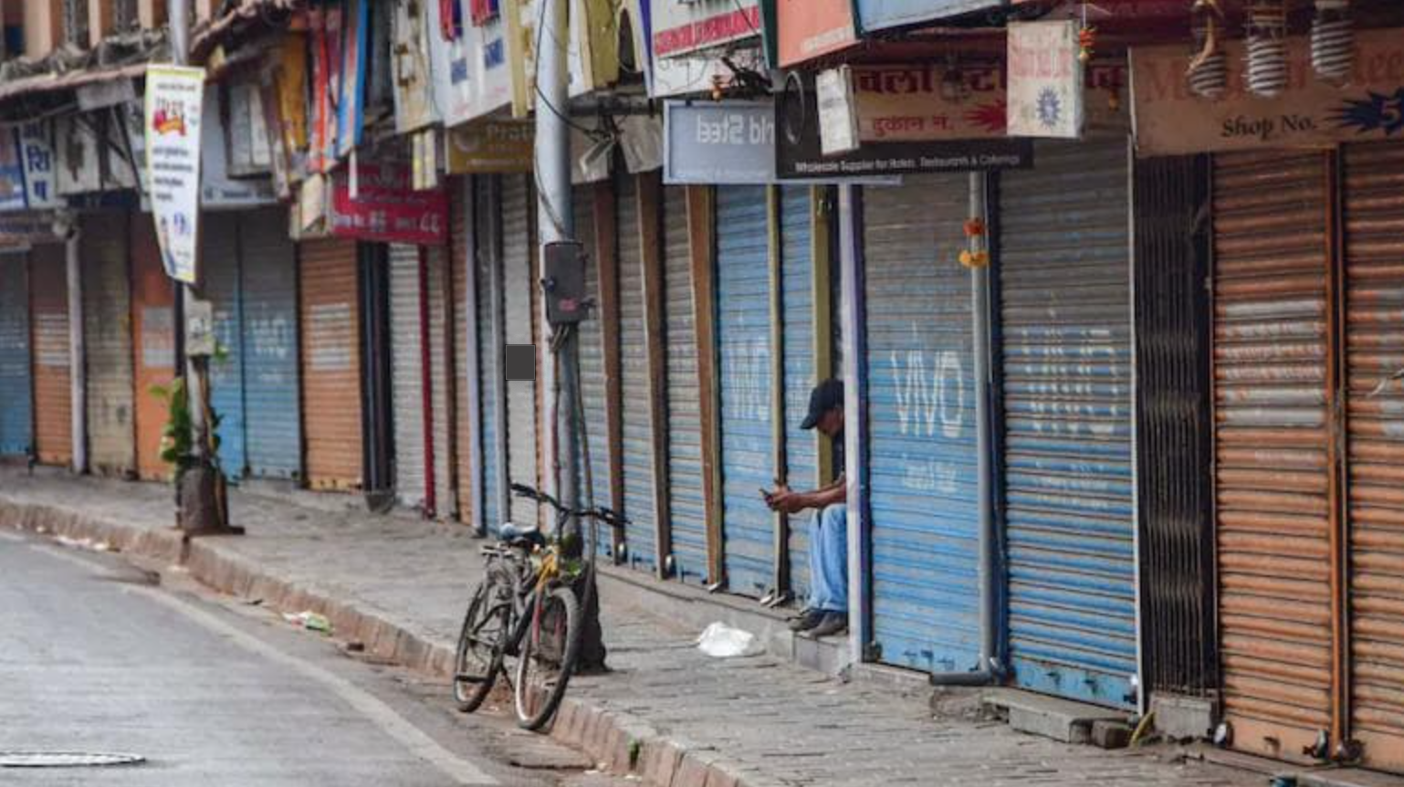
Motivation

Slide 4
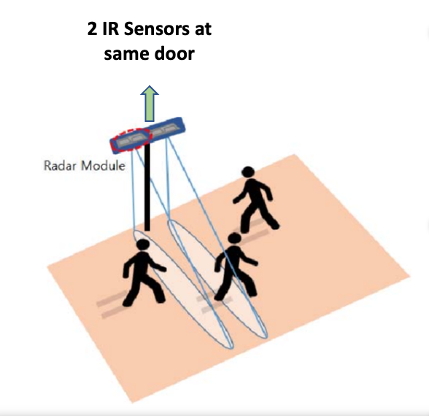
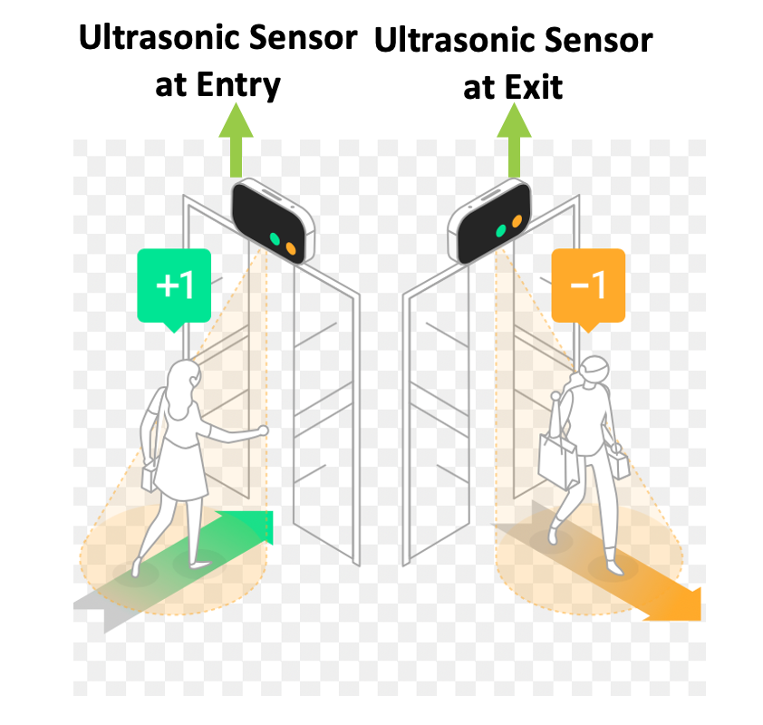
State of the art
Choi, J.W., Quan, X., & Cho, S.H. (2018). Bi-Directional Passing People Counting System Based on IR-UWB Radar Sensors. IEEE Internet of Things Journal, 5, 512-522.
IN LITERATURE SURVEY
WHAT WE DID

Slide 5
State of the art
In the recent past many researchers made smart door for covid prevention but only we have integrated Face mask detector, Temperature detector, Hand sanitizer detector and restricting the number of people inside a room together
Our model performs slightly better than previous suggested models because we have used OpenCV DNN for face detection.
We have used fine tuning method to get better accuracy in our model.

Slide 6
ML Model for Face Mask Detection and Classification
Model Training for Face Mask Classification
Face Detection

Slide 7
Data Collection and Division
Data is collected from : https://www.kaggle.com/omkargurav/face-mask-dataset
Our dataset contains 3725 with-mask images and 3828 without mask images.
Dataset is divided into:
Training Dataset : 2925 (with mask), 3028 (without mask )
Validation Dataset : 400 (with mask), 400 (without mask )
Test Dataset : 400 (with mask), 400(without mask )

Slide 8
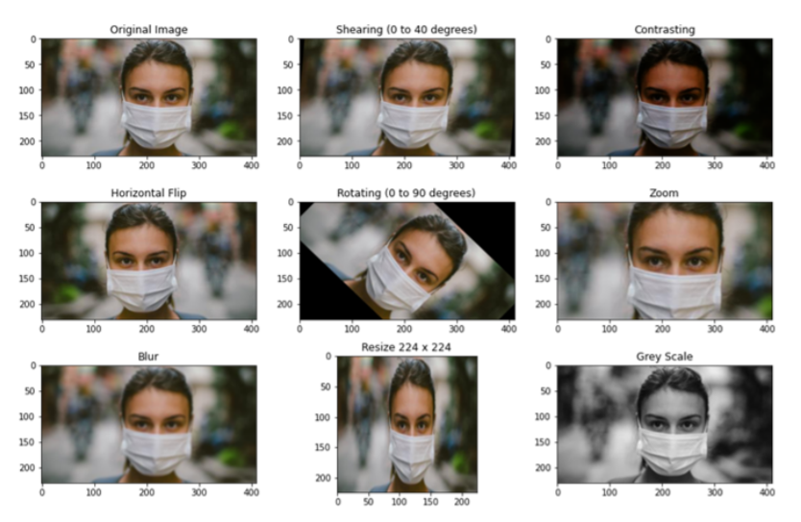
Data Augmentation
Image data augmentation is a technique that can be used to artificially expand the size of a training dataset by creating modified versions of images in the dataset.
It is done to increase the dataset size and variance, accuracy of test dataset.
Flip, Rotation, Scale, Zoom, Shear

Slide 9
Transfer Learning
Transfer learning is a machine learning method where a model developed for a task is reused as the starting point for a model on a second task.
Eg: knowledge gained while learning to recognize cars could apply when trying to recognize trucks
Transfer learning is usually done for tasks where your dataset has too little data to train a full-scale model from scratch.
Procedure
Initiate the base model and load pretrained weights into it.
Freeze the initial layer weights.
Add some new layers on top of base model.
Train the new model with dataset.

Slide 10
Fine Tuning
Fine-tuning is a way of applying or utilizing transfer learning. Specifically, fine-tuning is a process that takes a model that has already been trained for one given task and then tunes or tweaks the model to make it perform a second similar task. It is used to:
speed up the training
overcome small dataset size

Slide 11
MobileNet V2
MobileNetV2 is a classification model developed by Google. It provides real-time classification capabilities under computing constraints in devices like smartphones.
This implementation leverages transfer learning from ImageNet to your dataset.
MobileNets are small, low-latency, low-power models parameterised to meet the resource constraints of a variety of use cases.
The MobileNetV2 models are much faster in comparison to MobileNetV1. It uses 2 times fewer operations, has higher accuracy, needs 30 percent fewer parameters.

Slide 12
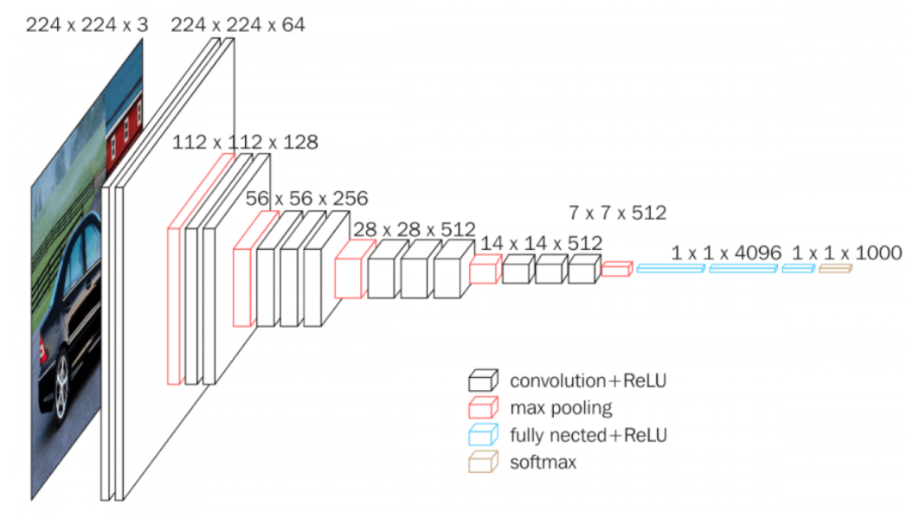
VGG 16
VGG16 is a convolutional neural network model proposed by K. Simonyan and A. Zisserman from the University of Oxford in the paper “Very Deep Convolutional Networks for Large-Scale Image Recognition” 2015.
Features:
The model achieves 92.7% top-5 test accuracy in ImageNet, which is a dataset of over 14 million images belonging to 1000 classes.
VGG 16 consist 16 layers with trainable parameters
Total parameters : 13 million
Number of channels double after every Max pooling layer.
VGG 19 has the same accuracy

Slide 13
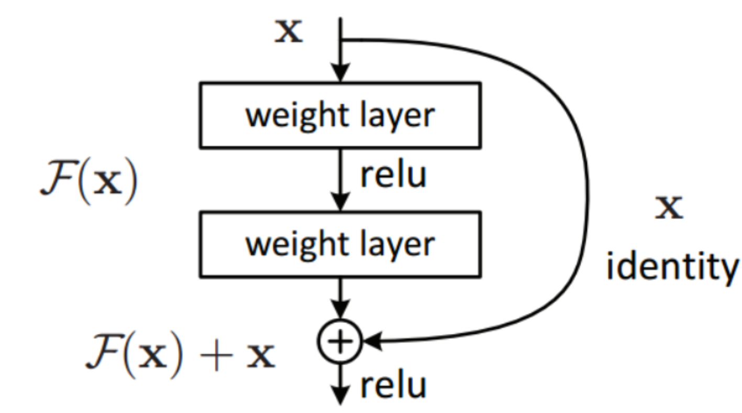
ResNet50
ResNet model was proposed by Kaiming He, Xiangyu Zhang, Shaoqing Ren, Jian Sun in “Deep Residual Learning for Image Recognition” 2015.
Features:
The ResNet-50 model consists of 5 stages each with a convolution and Identity block. Each convolution block has 3 convolution layers and each identity block also has 3 convolution layers.
Skip Connections : Solve the problem of vanishing gradients and help in learning identity function.
Total parameters : 23 million.
It achieve the Top 5 accuracy of 80.67% on imagenet dataset.

Slide 14
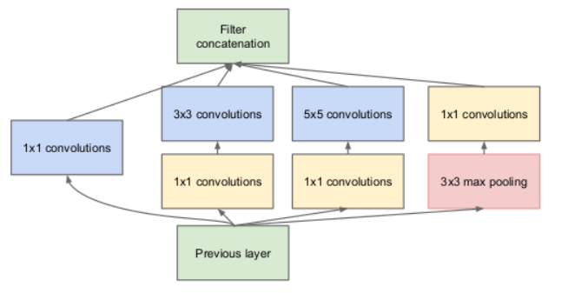
Inception
This architecture is proposed by Google in 2014 in the paper “Going deeper with convolutions”.
Features:
GoogLeNet has 9 such inception modules stacked linearly. It is 22 layers deep (27, including the pooling layers).
It archives the accuracy of 93.30% over imagenet dataset.
Total parameters : 6.4 Million.
Using 1x1 Convolution layers reduce the number of floating point operation in the forward pass.

Slide 15
Model Training
Once dataset is fetched we divided it into three separate folders named : Training Set, Validation Set and Test Set
We applied Data augmentation on our training dataset.
We built our model using transfer learning from MobileNetV2 model.
We add global average pooling layers and 4 dense layers each followed by dropout layers.
In last layer it has two node with sigmoid activation function.
We trained our model for 5 epochs by keeping the weights of MobileNetV2 model constant.
We trained our model again for 10 epochs and this time weights of MobileNetV2 model was also trained.
We also used validation set hyper parameter tuning.
Once our model is trained we did testing using test dataset.
Now our model is completely trained and ready for facemask detection.

Slide 16
Comparison between different Models
 | VGG 16 | ResNet50 | Inception | MobileNetV2
Total Parameters | 14,863,358 | 24,129,778 | 22,344,850 | 2,603,442
Model Size | 170 MB | 276 MB | 256 MB | 30.2 MB
Train set accuracy | 99.78% | 91.87% | 99.78% | 99.82%
Validation set accuracy | 99% | 92.12% | 100% | 99.75%
Test set accuracy | 99.25% | 92.5% | 100% | 99.625%

Slide 17
Face Detection
Face detection is generally the first step towards many face-related applications like face recognition or face verification.
For face mask classification we first need to detect the face then pass it to the model.
It can be done using four libraries in python:
Haar Cascade
MTCNN
Dlib
OpenCV DNN

Slide 18
Comparison between different face detection models.
 | Haar Cascade | Dlib | MTCNN | OpenCV DNN
Side Face | ╳ | ╳ | ╳ | Best
Fast Head Movement | Worst | Worst | Good | Best
Occlusion of face | Good | Worst | Moderate | Best
Dim light | ╳ | Moderate | ╳ | Best

Slide 19
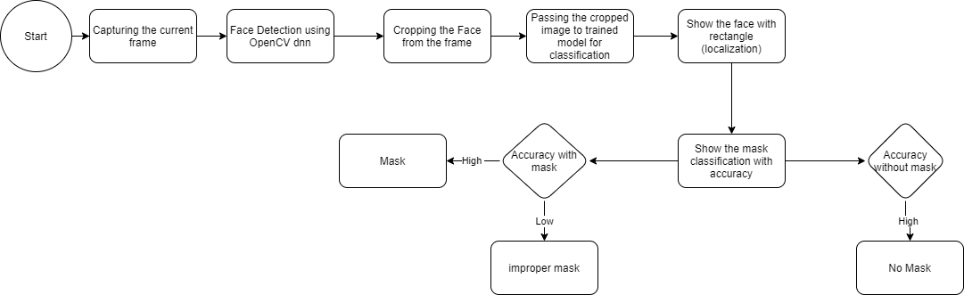
Workflow

Slide 20
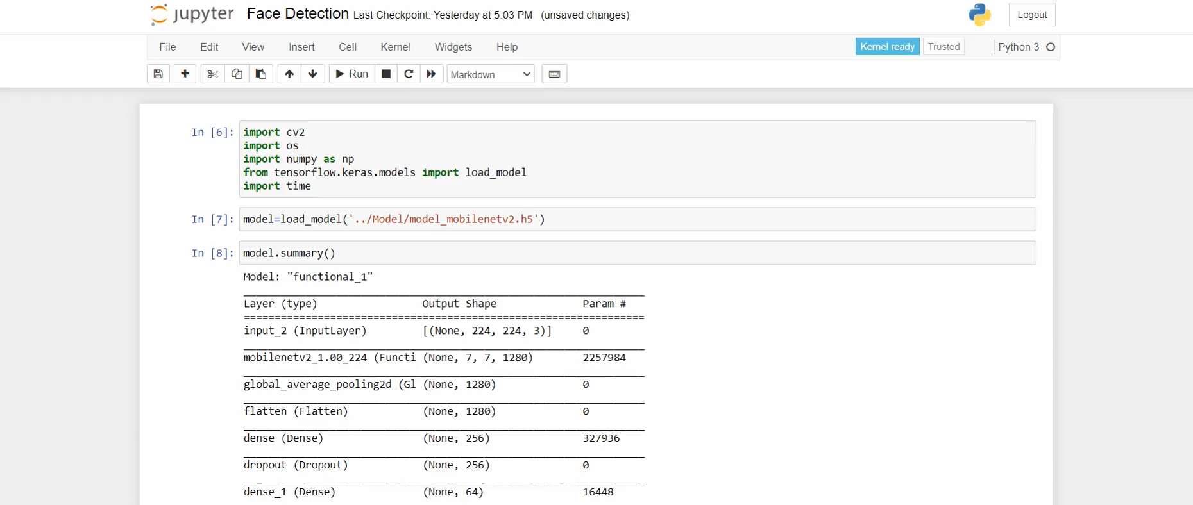
DEMO

Slide 21
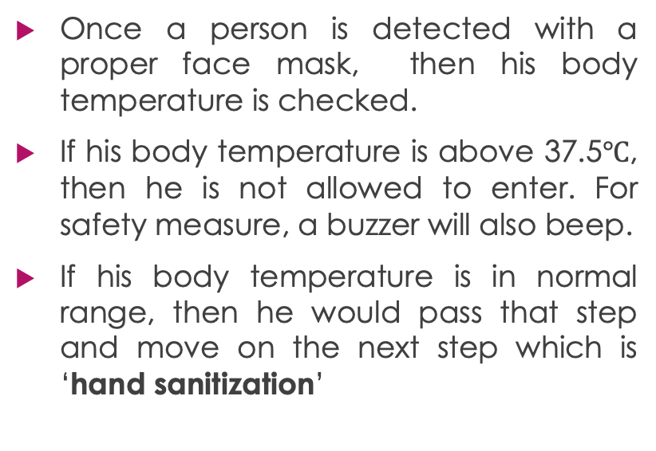
Temperature Detection

Slide 22
Automatic Hand sanitizer
Once a person passes temperature detection stage, he then moves to sanitize his hands.
No person is allowed inside without sanitizing their hands. So, It is a mandatory task.
An Ultrasonic sensor is used for Hand sanitizer.
Once his hands comes closer to the sensor(15 cm), a spray is ejected through the nozzle of the sanitizer.

Slide 23
Allowing up to a certain number of people
Now, after fulfilling all the previous steps which were
Wearing a face mask
Normal body temperature
Sanitizing hands
Then if people inside the room are below a certain threshold, then only the person will be allowed otherwise buzzer will beep and the person will not allowed to enter inside.
2 ultrasonic sensors are used at separate entry exit doors to ensure social distancing.

Slide 24
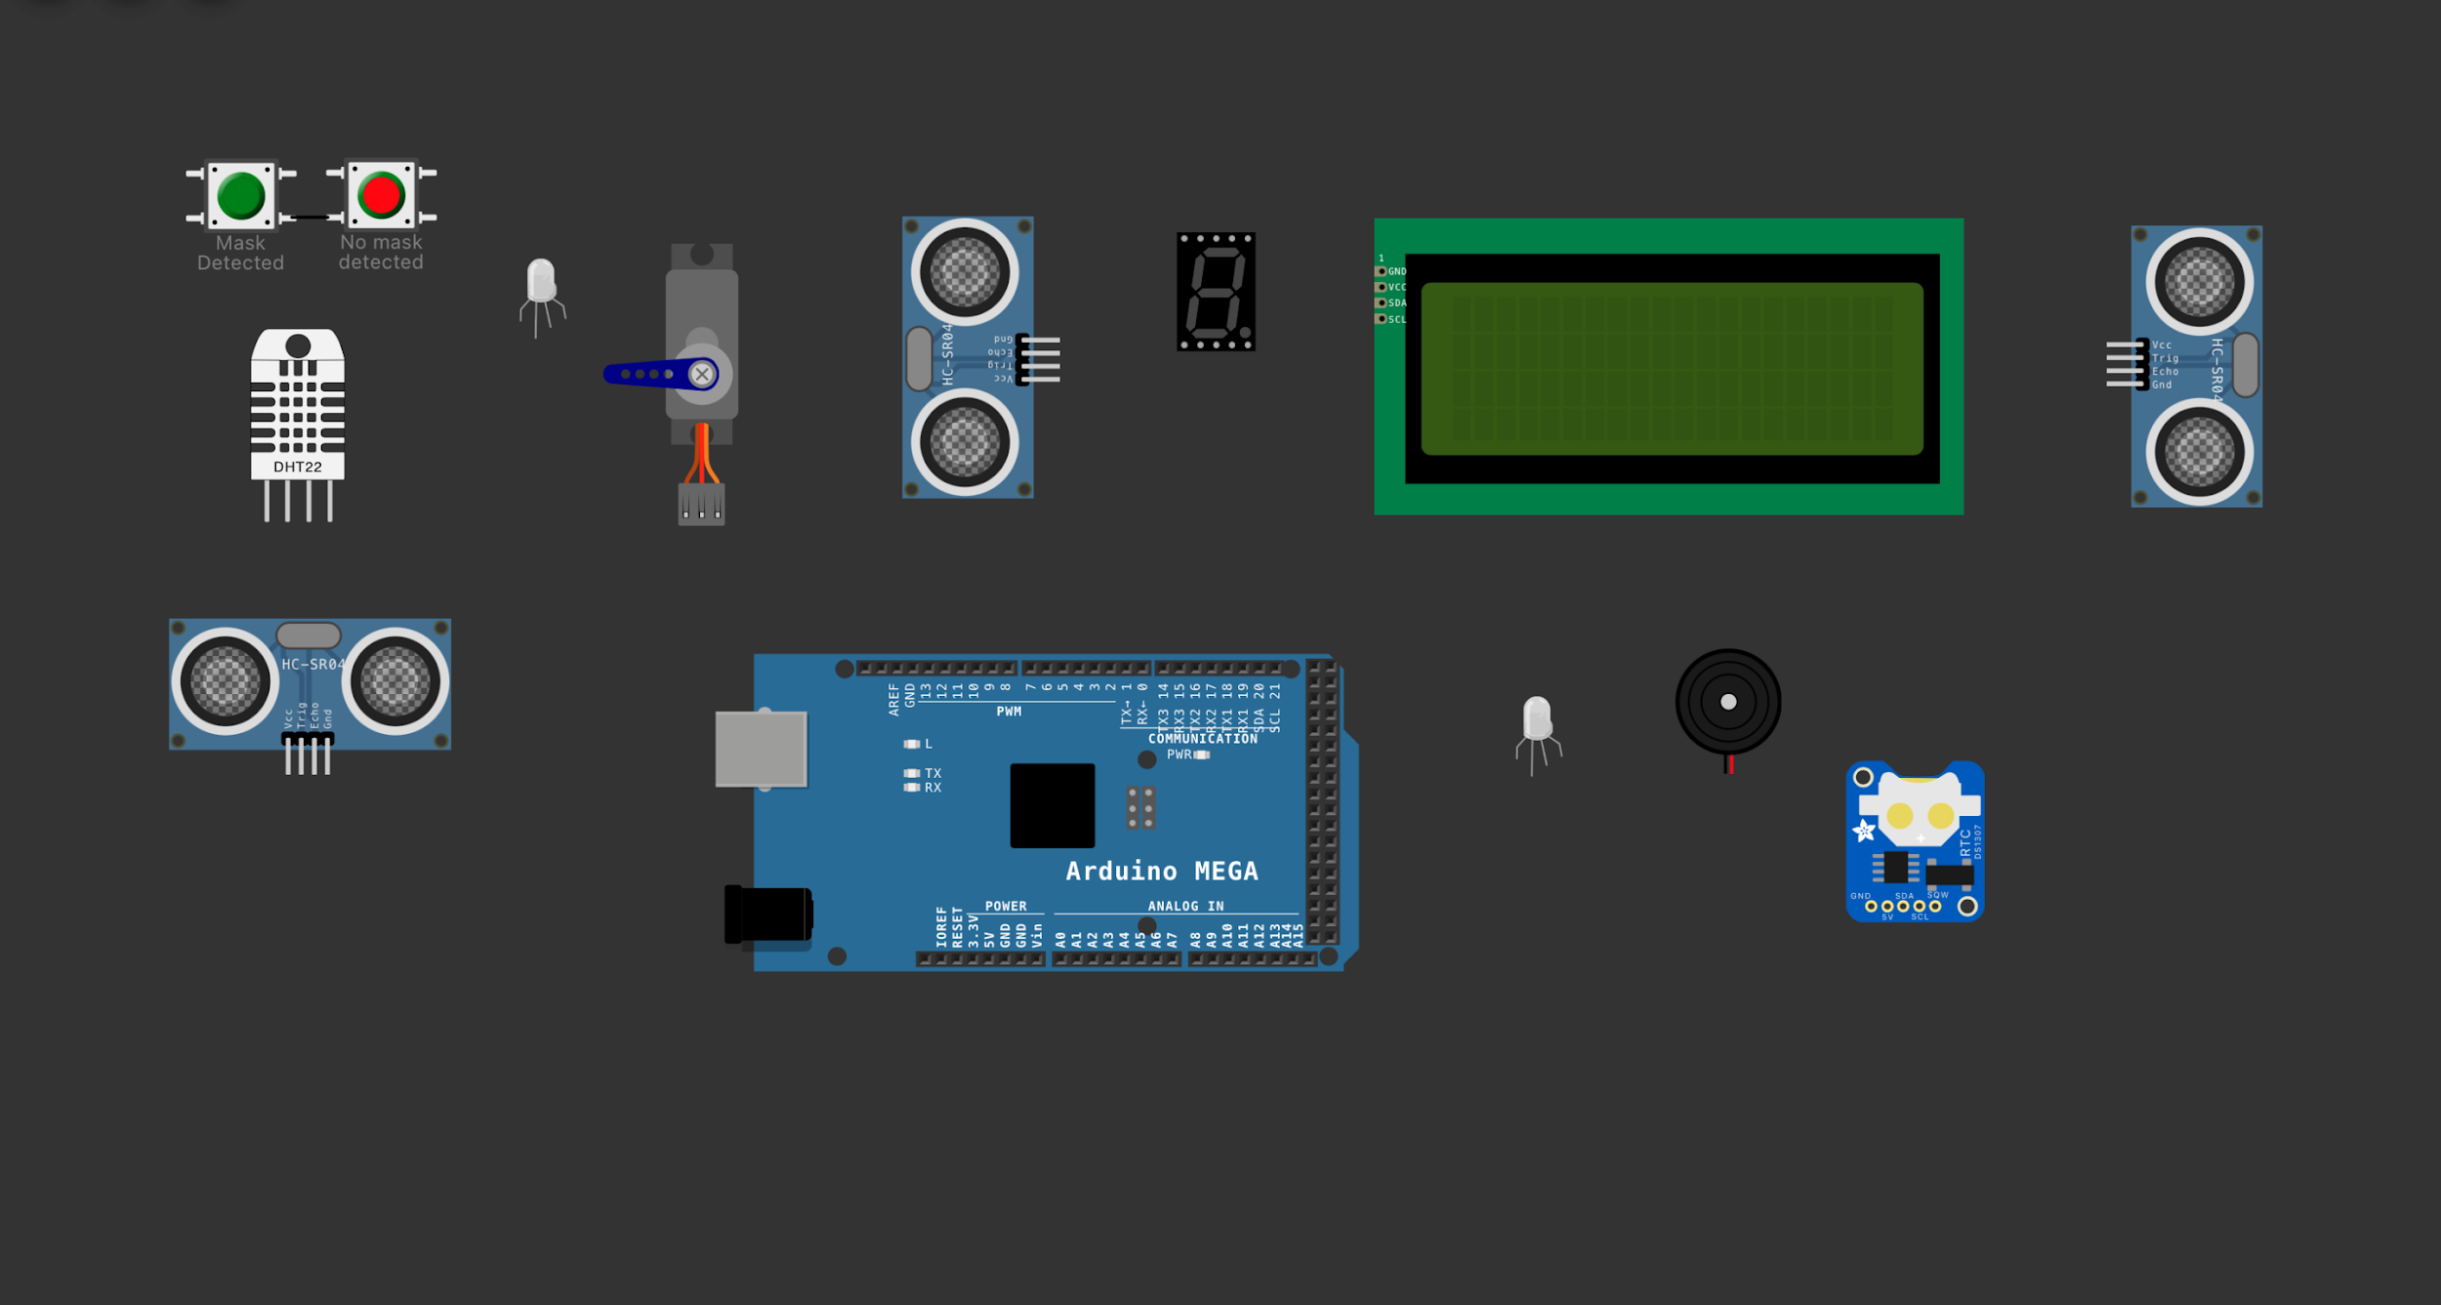
Displays number of people inside
Servomotor to open the door
Displays current status of the system
Sensor to measure Temperature
Ultrasonic sensor at entry
Ultrasonic sensor at exit
RTC (Real Time Clock) module
Ultrasonic sensor used for Hand sanitizer
Buzzer in case of emergency
Arduino MEGA IoT board

Slide 25
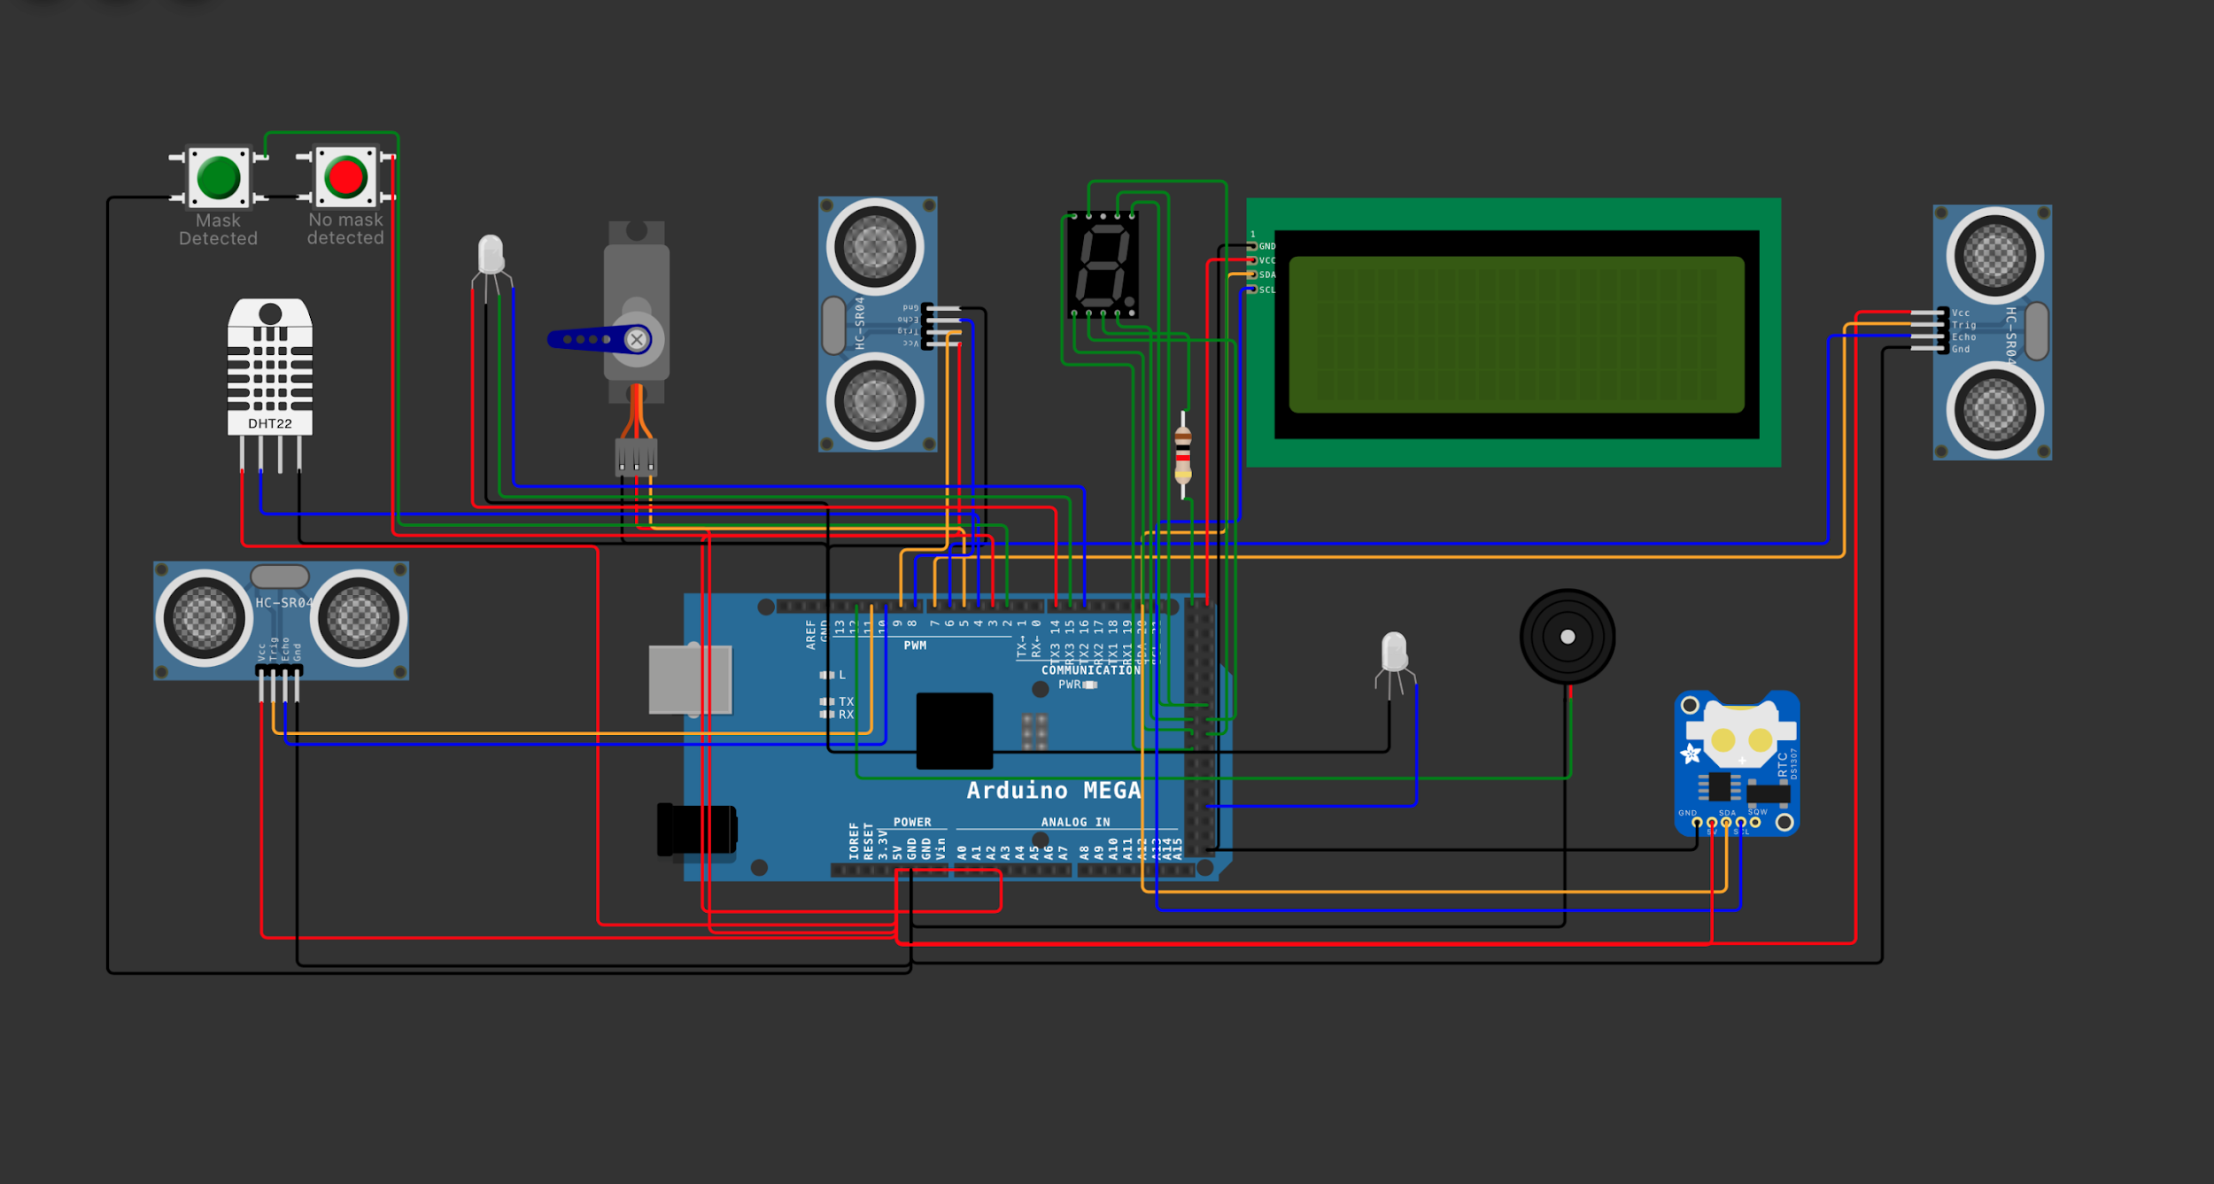

Slide 26
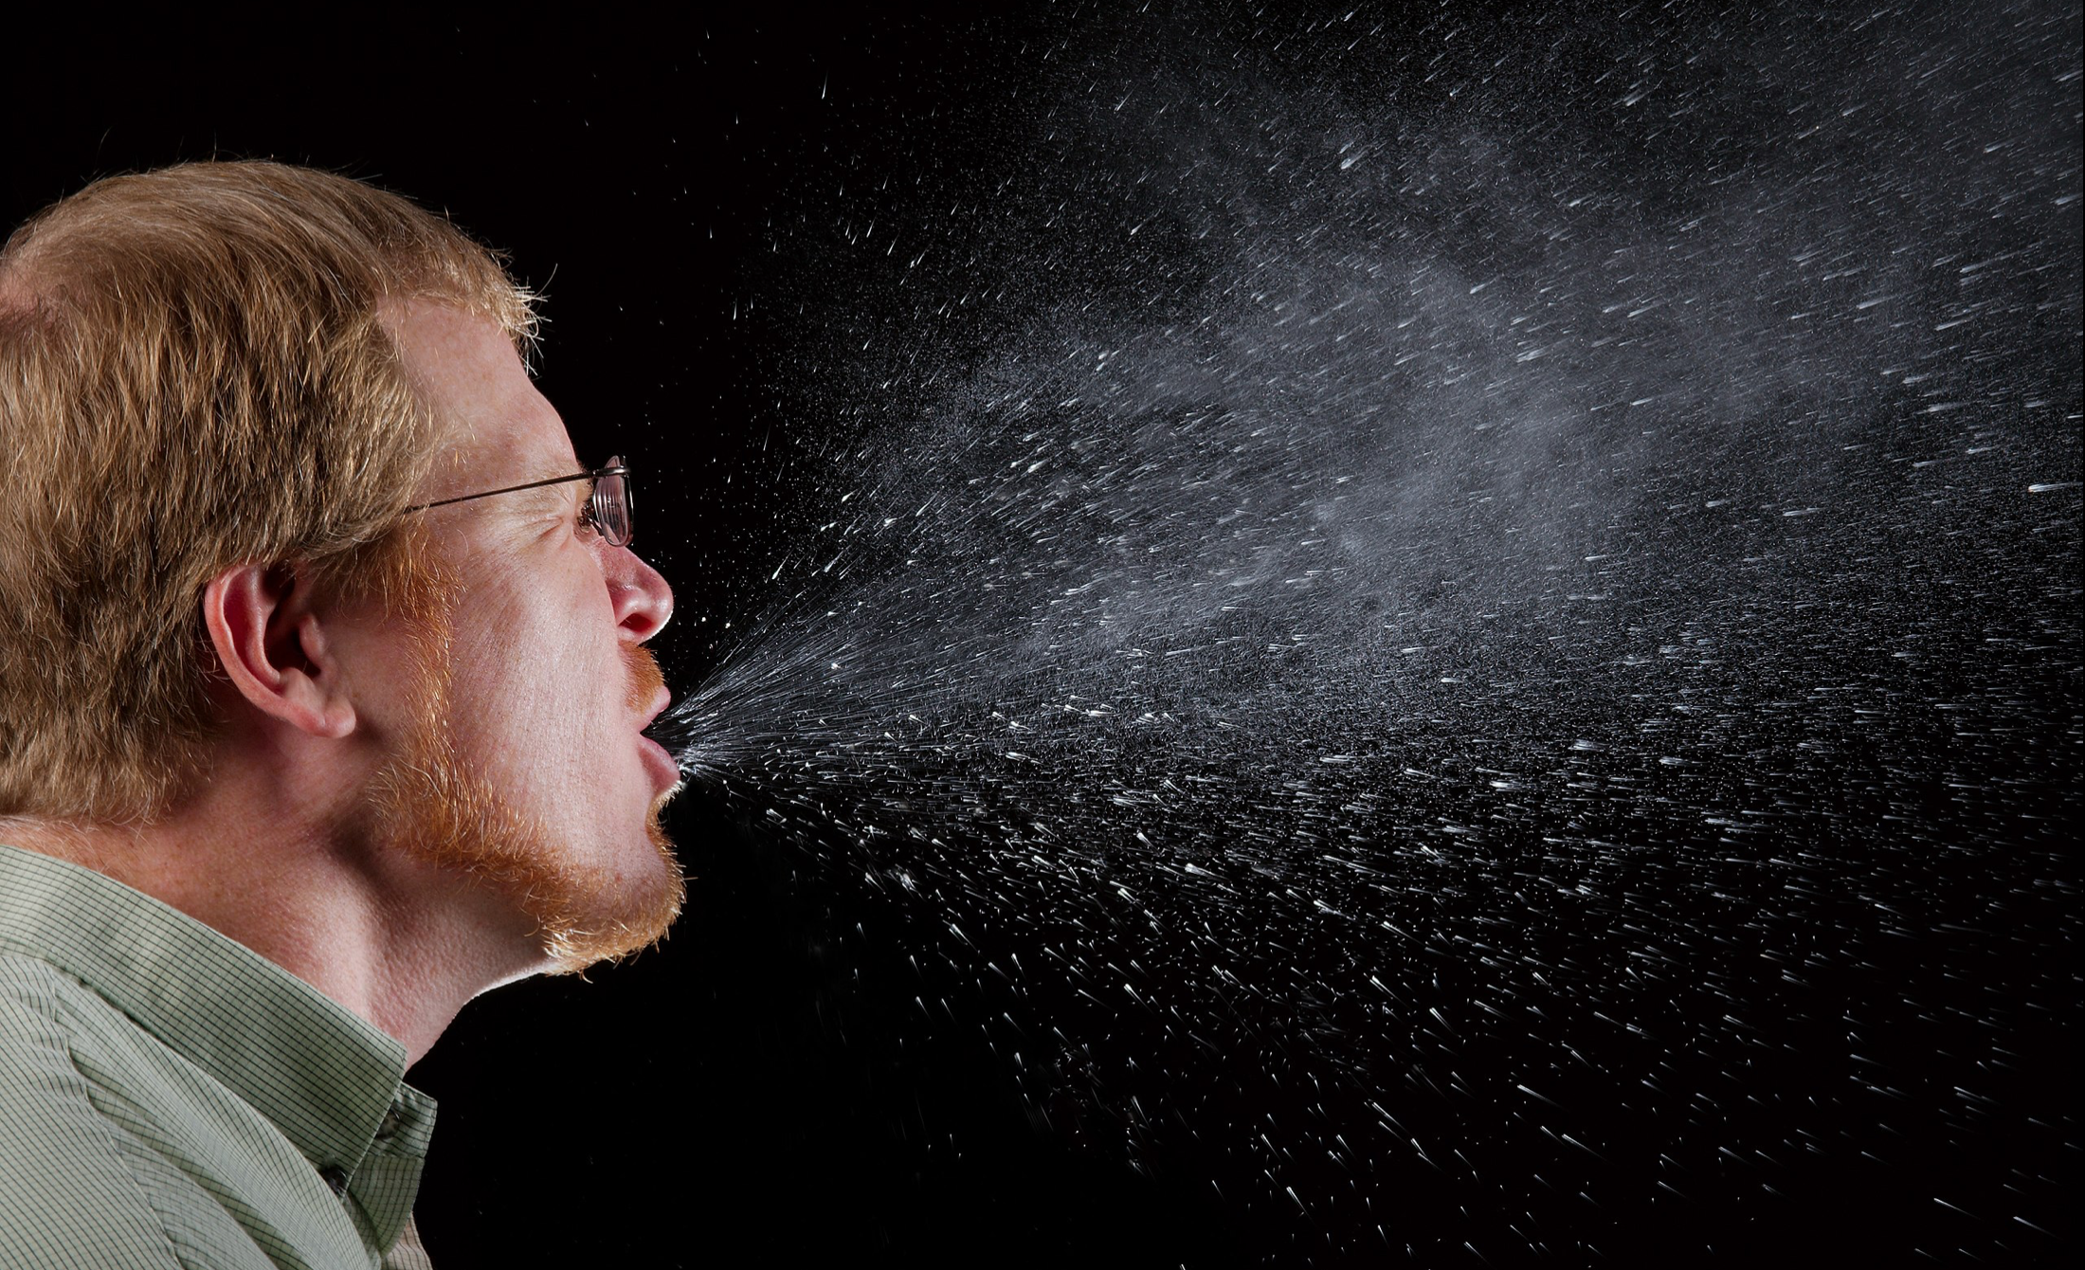
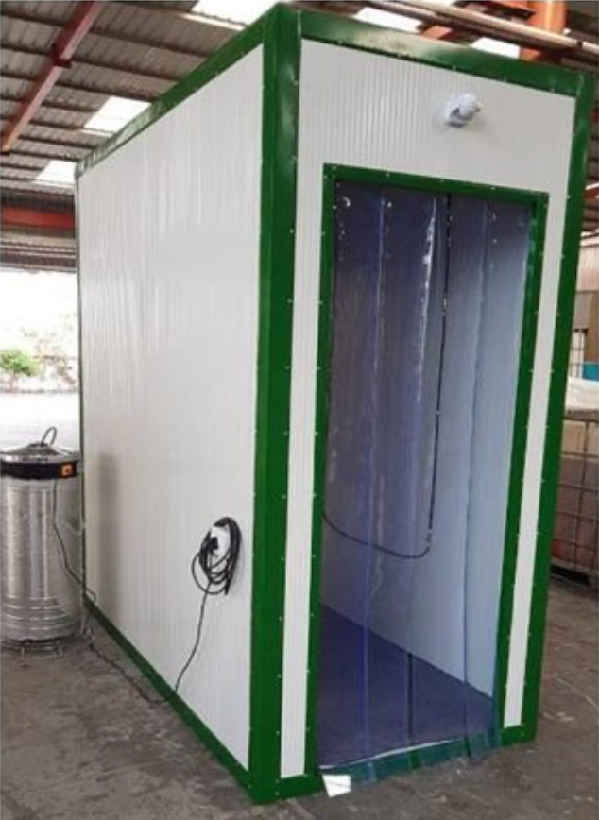
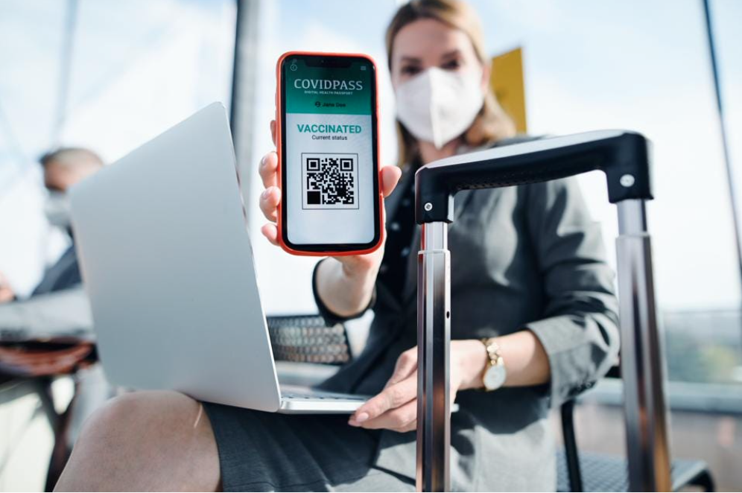
Future work
Sneeze Detector
Vaccination Status through QRcode
Full Body Disinfection Chamber

Slide 27
Task | Ankit | Anuj | Himanshu | Manish
Literature Survey | ✔️ | ✔️ | ✔️ | ✔️
Making Presentation | ✔️ | ✔️ | ✔️ | ✔️
Report Writing | ✔️ | ✔️ | ✔️ | ✔️
Data Collection and Pre-processing | ✔️ |  | ✔️
Face mask Classification Training | ✔️ |  | ✔️
Face Detection | ✔️ |  | ✔️
Comparing Different Models | ✔️ |  | ✔️
Temperature Detection |  | ✔️ |  | ✔️
Hand Sanitization |  | ✔️ |  | ✔️
Counting number of people |  | ✔️ |  | ✔️
Smart Home Appliance |  | ✔️
Final Integration |  | ✔️ |  | ✔️

Slide 28
Anuj Shrivastava – 25% Ankit Raja – 25% Himanshu Lal - 25% Manish -25%

Slide 29
Literature References
[1] An Automated System to Limit COVID-19 Using Facial Mask Detection, IEEE 2020, Mohammad Marufur Rahman, Md. Motaleb Hossen Manik, Md. Milon Islam, Saifuddin Mahmud, Jong-Hoon Kim
[2] IoT-Enabled Smart Doors for Monitoring Body Temperature and Face Mask Detection, Global Transitions Proceedings 2021, B Varshini , HR Yogesh , Syed Danish Pasha , Maaz Suhail ,V Madhumitha , Archana Sasi
[3] SSDMNV2: A real time DNN-based face mask detection system, Sustainable Cities and Society 66 (2021), Preeti Nagrath , Rachna Jain , Agam Madan , Rohan Arora , Piyush Kataria ,Jude Hemanth
[4] Detection of Face Mask using Convolutional Neural Network, Riya Chiragkumar Shah, Rutva Jignesh Shah

Slide 30
Literature References
[5] Bi-Directional Passing People Counting System Based on IR-UWB Radar Sensors ,Jeong Woo Choi, Xuanjun Quan, and Sung Ho Cho
[6] Self-Activating Sanitizer With Battery Imposed System For Cleansing Hands Mr. M. M. Srihari
[7]. Internet of Things for Smart Cities Andrea Zanella, Senior Member, IEEE, Nicola Bui, Angelo Castellani, Lorenzo Vangelista, Senior Member, IEEE, and Michele Zorzi, Fellow, IEEE
[8] Smart Door System with COVID-19 Risk Factor Evaluation, Contactless Data Acquisition and Sanitization, ICAIS-2021, Akshay Duth, Abhinav A Nambiar ,Chintha Bhanu Teja ,Sudha Yadav

Slide 31
Thank You
Any Questions?

